Slide 1
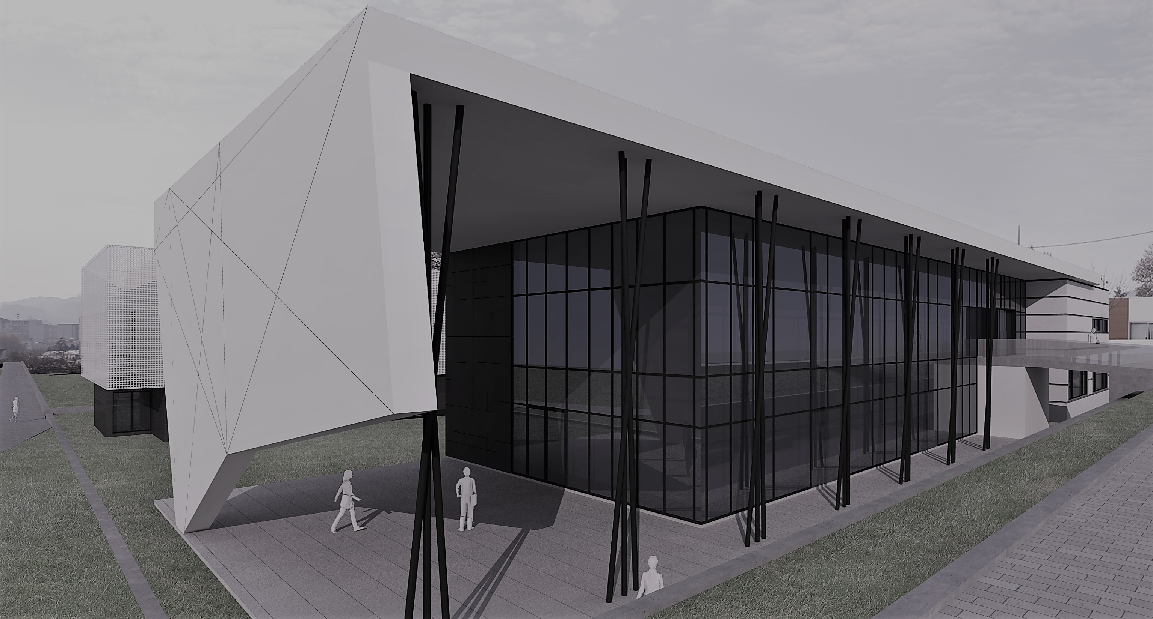



José Henrique Brito

Slide 2




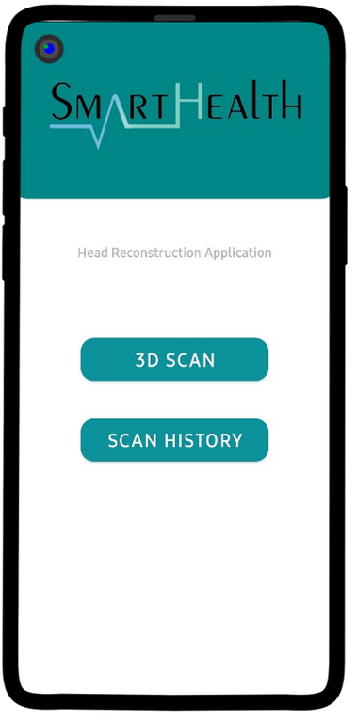
SMARTPHONEHEADSCANNER
Data Acquisition
3D Reconstruction
Results Visualization
System to acquire a set of sequential images and intrinsic data.
Neural rendering system to reconstruct human heads from 2D images.
Visualization and interaction with 3D objects.

Slide 3
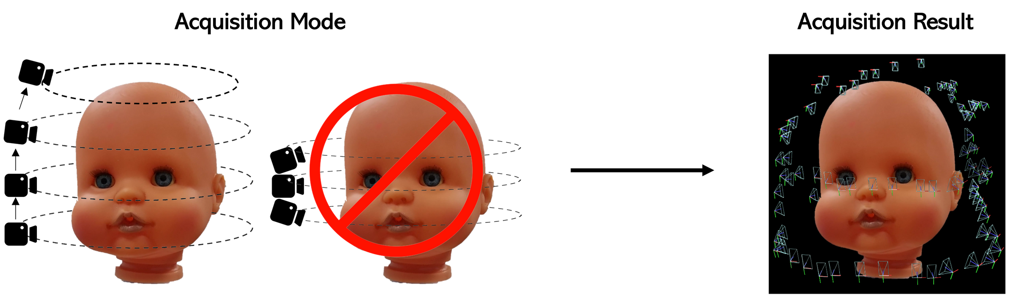

SMARTPHONEHEADSCANNER – Data Acquisition System
Circular movements from different viewpoints
Perpendicular angles to the target
Cover a 360° view of the target
Slow movements

Slide 4
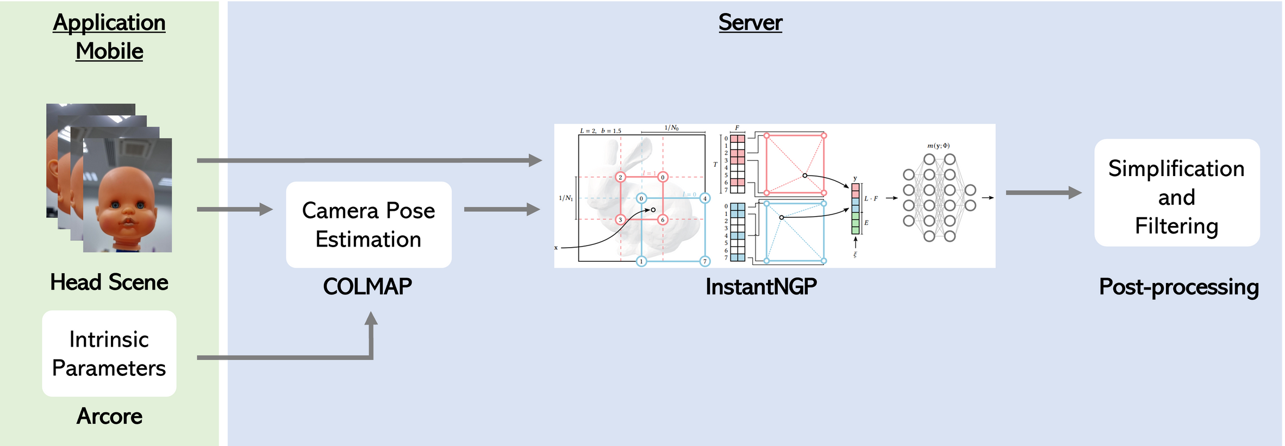
SMARTPHONEHEADSCANNER – 3D Reconstruction System

Slide 5
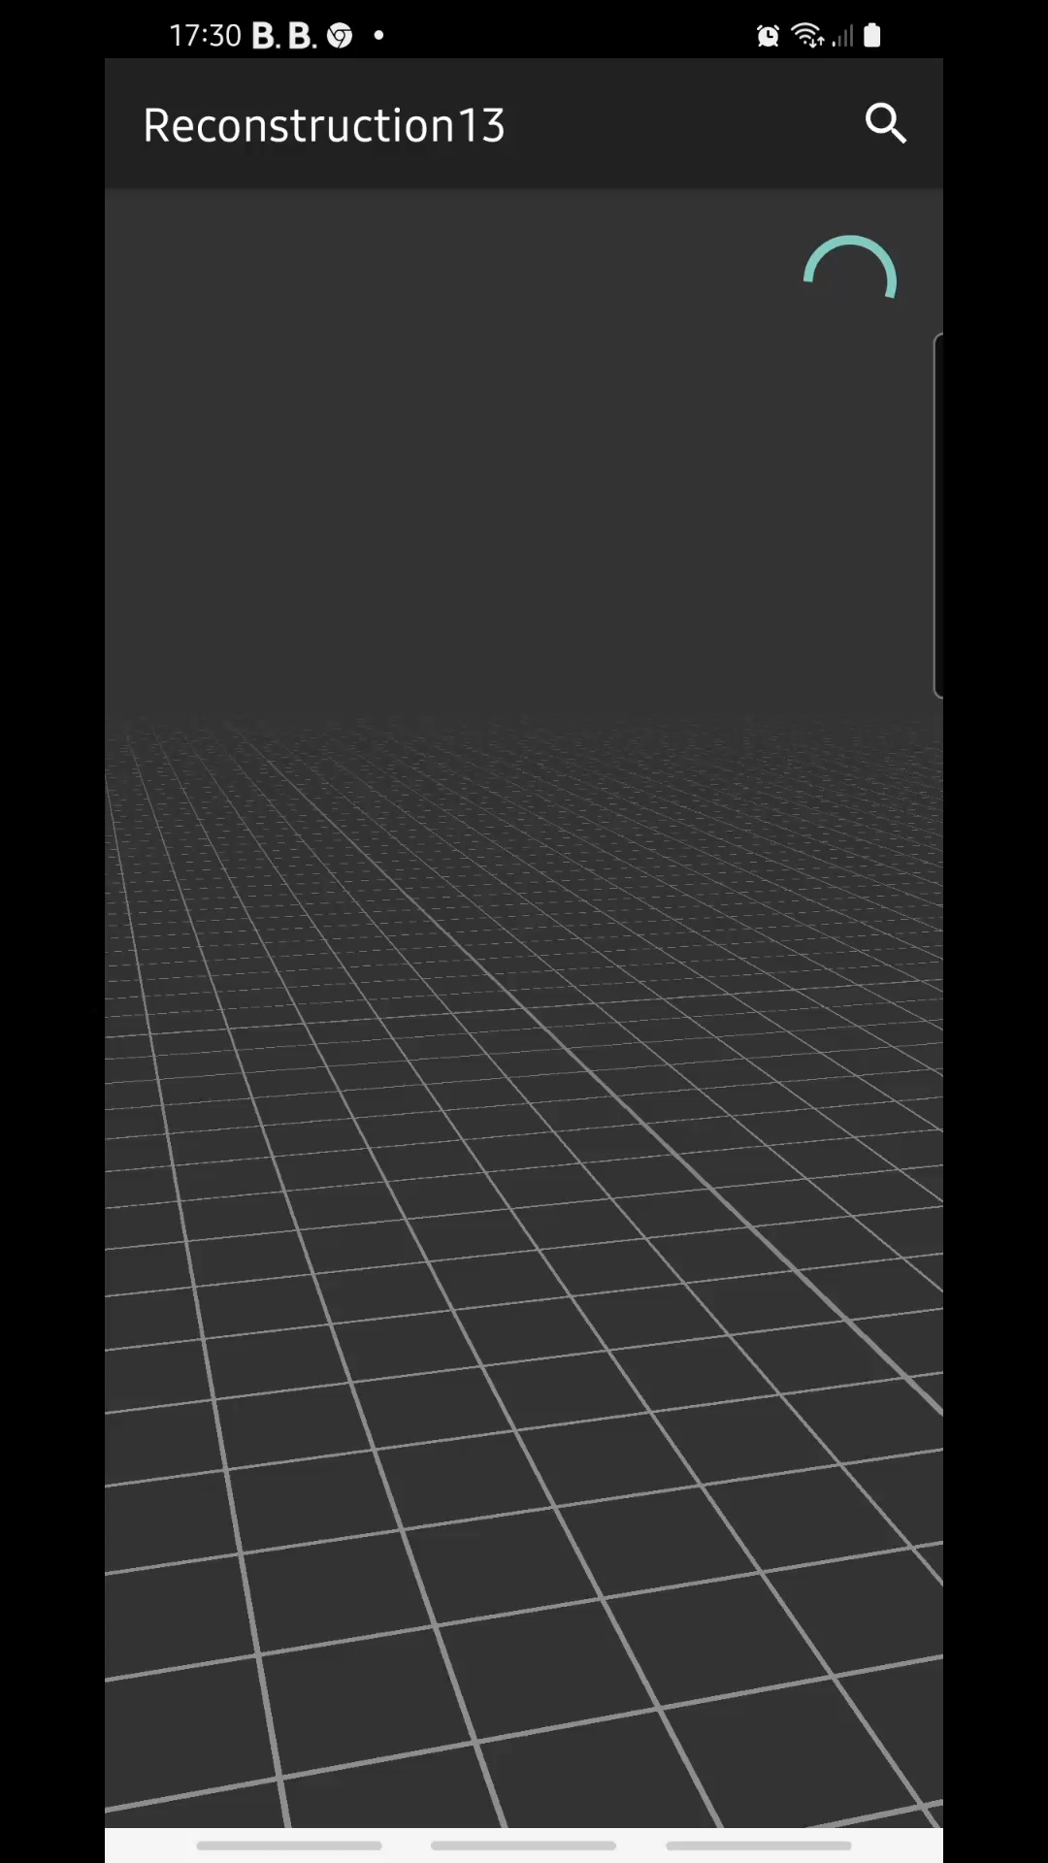
SMARTPHONEHEADSCANNER – Results Visualization
3D object visualization is designed through an interactive interface developed using OpenGL ES 2.0 in Kotlin.
Characteristics:
Background frame color as grey
Culling to remove back faces
Enable depth testing
Added grid lines to the floor

